Slide 1
Theory of Computation
Slides 1
Dr. Talha Waheed
UET, Lahore

Slide 2
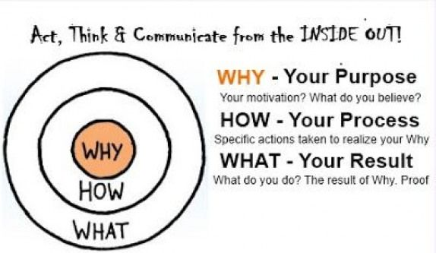

Theory of Computing – Why, How and What?

Slide 3
Goals
Core of everything - To introduce elegant theory that underlies computing since its early days (and it is still alive).
2. To motivate students about (abstract) models of computation and their limits
3. To show students how to apply theory in their own work (applications).

Slide 4
Why do we study Computing?
What is Computer Science? What and how do we do?
Is it a right name for the discipline, what else you suggest?
What is computing? What other names do you suggest?
Is computing depends on the medium?
Are they only electronic or digital?
syntax is independent of medium (not intrinsic to physics).
We assign semantics to syntax (symbols)

Slide 5
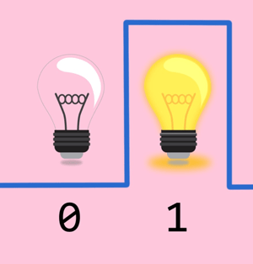
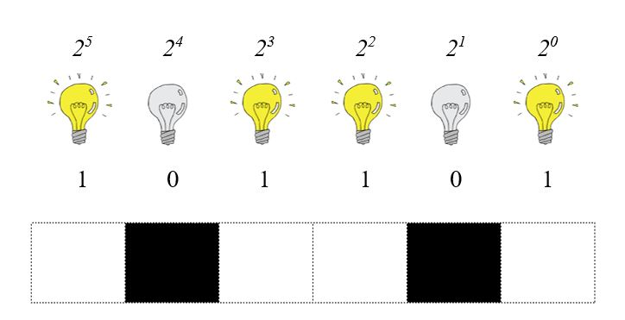
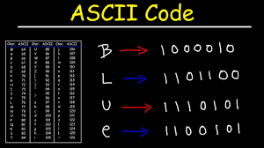
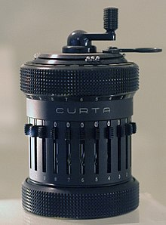
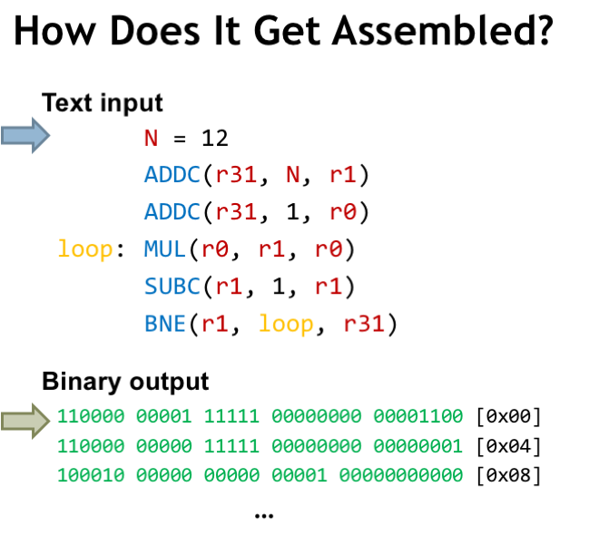
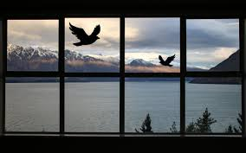

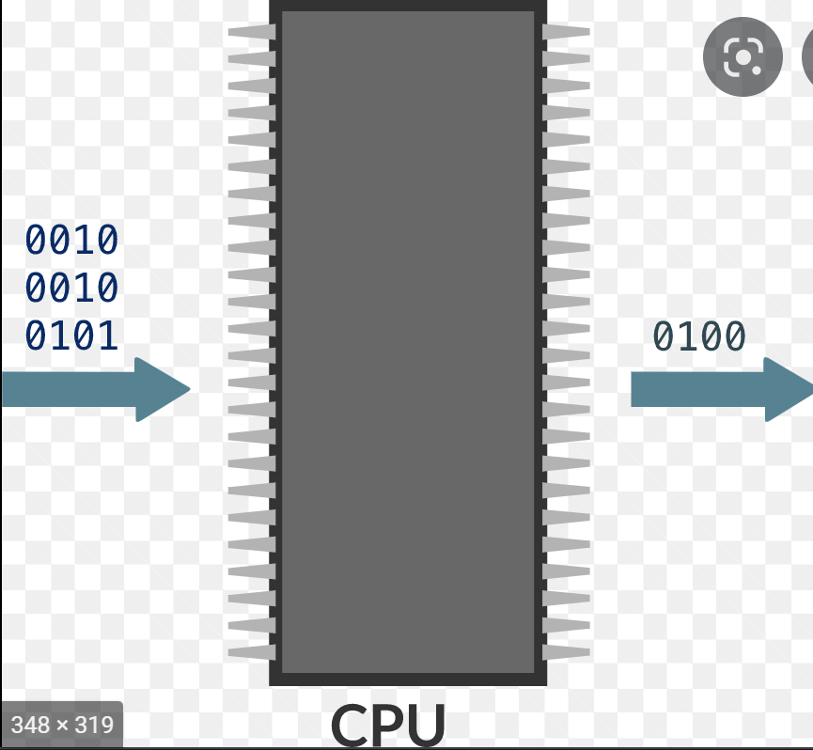
Syntax
Programs are purely syntax (formal rules).
Is Data & Programs (in Computers) are defined syntactically by Binary numbers?
Is Syntax a physical feature of computers?
Syntax is not intrinsic (built in) to physics.
Computational states (syntax) are not built-in within the physical medium, they are assigned by some outside person.
Hardware realization to computational description is abstract.
A water pump/birds/mechanical computer or even "a group of pigeons can be trained to peck as a Turing machine”

Slide 6
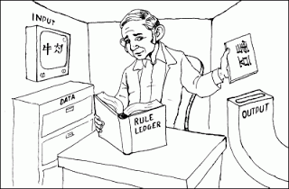
Semantics
Next issueis : How do the syntax get its meaning (semantics)?
Even Semantics is not intrinsic (built-in) to syntax.
An outside person encodes some information in a form that can be processed by the circuitry of the computer. He/she provides a syntactical realization of the information that the computer can implement in, e.g., different voltage levels.
Computer goes through a series of electrical signals that the outside person can interpret both syntactically and semantically even though, of course, the hardware has no intrinsic syntax or semantics:
It is all in the eye of the beholder.
Chinese Room Argument

Slide 7
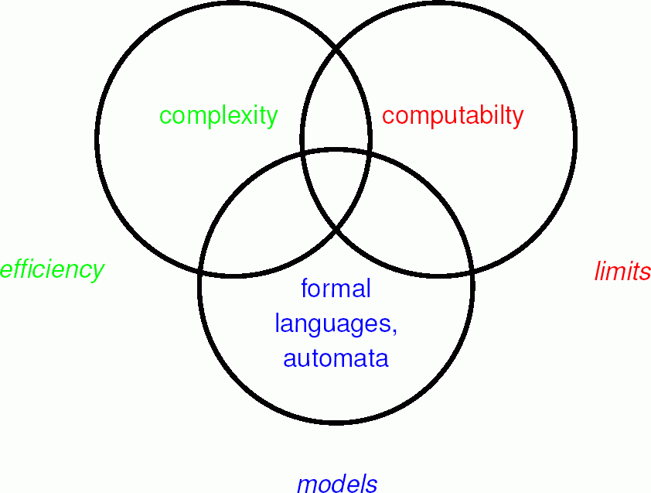
Three Interlinked Subjects

Slide 8
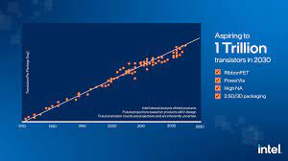
Moore’s Law of Transistor in the Computer
Moore stated it in 1965
speed and capability of computers can be expected to double every two years, as a result of increases in the number of transistors a microchip can contain.

Slide 9

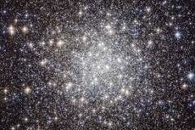
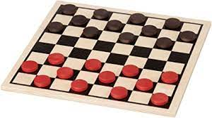
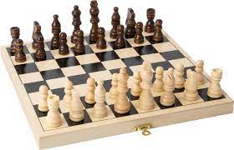
How big is big?
Earth has 7.5 x 10¹⁸ grains of sand
Different estimates 10²⁴ or 200 billion trillion stars
70 thousand million, million, million stars in the observable universe (a 2003 estimate), so that we've got multiple stars for every grain of sand.
10⁴⁰ Possibilities in Checker (Chinese Chess)
10¹²⁰ Possibilities in Chess
10⁻³⁵⁰ Probability of Human Evolution from Single cell
10⁻⁹⁵⁰ Probability of Human Evolution (if we consider Genes)

Slide 10
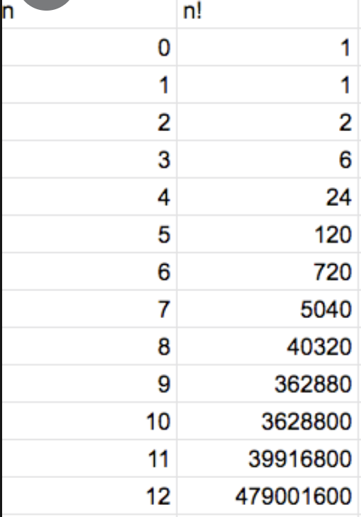
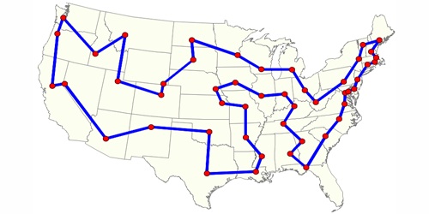
Travelling Salesman problem
The speed of light is 3*10⁸ m/sec. The width of a proton is 10⁻¹⁵ m. So, if we perform one operation in the time it takes light to cross a proton, we can perform 3*10²³ operations/sec. There have been about 3*10¹⁷ seconds since the Big Bang.
So, at that rate, we could have performed about 9*10⁴⁰ operations since the Big Bang. But 36! is 3.6*10⁴¹.
So there hasn’t been enough time since the Big Bang to have solved even a single traveling salesman problem with 37 cities. That’s fewer than one city per state in the United States.
43! = 6*10⁵²
^{70! = 1.2} *10¹⁰⁰
^{Google?}
^{Googleplex?}

Slide 11
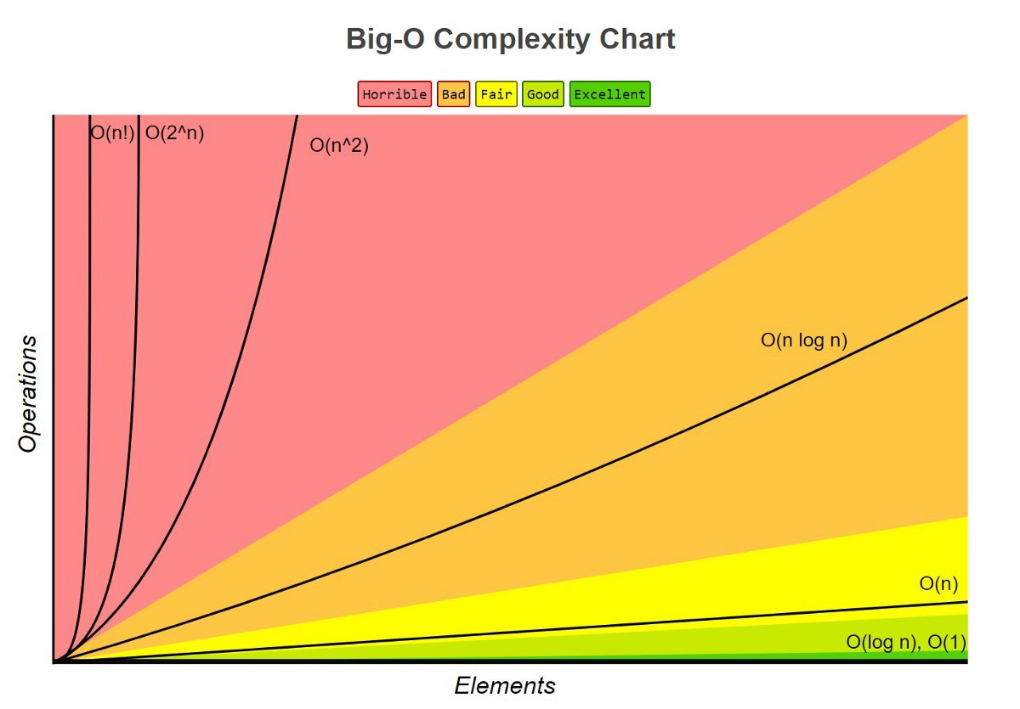

Slide 12
